Slide 1
Branding and packaging

Slide 2


Slide 3
Brand
A name, logo, or symbol that evokes in customers a perception of added value for which they will pay a premium price
“A product with a personality.
A name or symbol used to identify the source of goods or services, and to differentiate them from those of others

Slide 4
BRANDING
Branding is the process of identifying the name of a producer with his product by affixing to the product or it contains the trade name or brand represented by words or design.
BRAND NAME A brand name consists of words, letters or numbers which may be vocalized or pronounced.

Slide 5
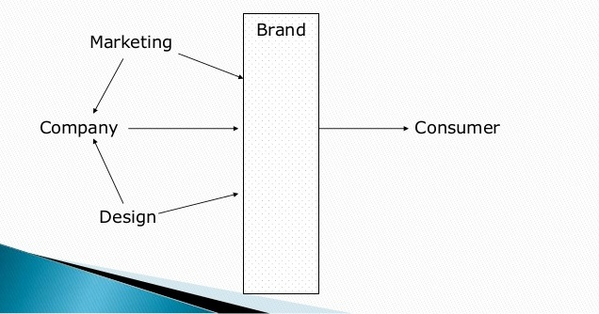

Slide 6
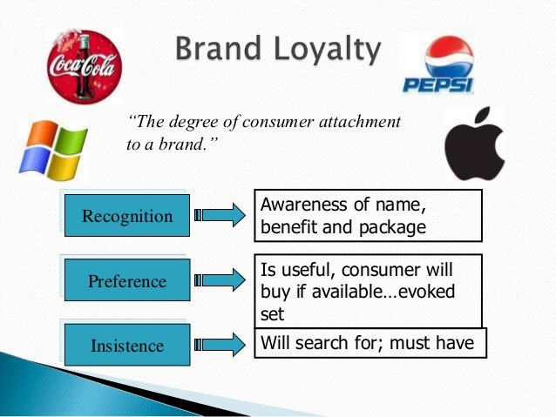

Slide 7
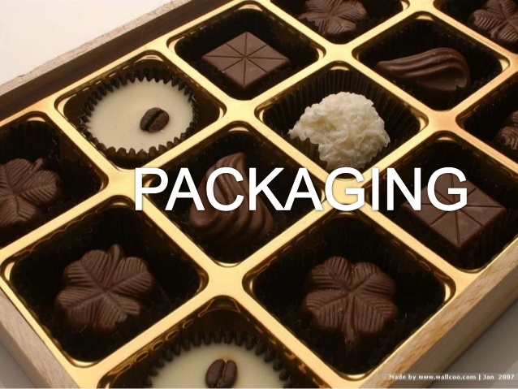

Slide 8
Packaging is the technology of enclosing or protecting products for distribution, storage, sale, and use.
Packaging contains, protects, preserves, transports, informs, and sells.
Packaging is one of most important parts of marketing.
As clothing is for humans ,packaging is for products.
The primary role of packaging is to contain, protect and preserve a product as well as assist in its handling and final presentation.
The package is physical container or wrapping for product.
It is an essential part of product planning and promotion.

Slide 9
Packaging provides following benefits to the goods:
Physical Protection.
Marketing:
Convenience
Product Attractiveness

Slide 10
Types of Packages
Primary Package
Secondary Package
Tertiary Package

Slide 11
Primary Package: It is the material that first envelops the material and holds it.

Slide 12
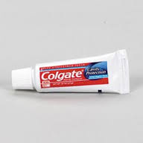

Slide 13
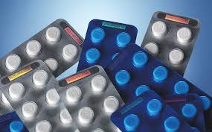

Slide 14
Secondary Packaging: used to group primary packages together.

Slide 15


Slide 16
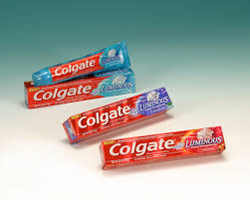

Slide 17
Tertiary Packaging: Used for bulk handling, warehouse storage and transport shipping.

Slide 18
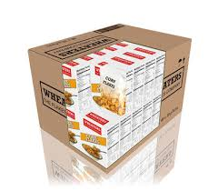

Slide 19
That’s all ☺ ☺

